Slide 1
Symfony
Version : 1.0.4

Slide 2
How to use it
Create a project
Folder structure
Module
Yaml format config
Database

Slide 3
Create a project
Environments
Step1. Get source code
http://symfony.com/download
Step2. Extract
tar zxvf symfony-1.4.20.tar.gz /usr/local/symfony
Step3. Set path bash_profile
vim ~/.bash_profile add export PATH=/usr/local/symfony/data/bin:$PATH

Slide 4
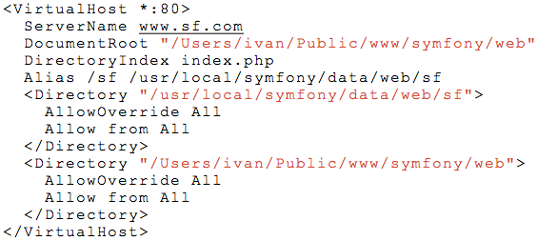
Create a project
Create a project
Step1. Create a folder for a project
mkdir /home/symfony
Step2. Create a project
cd /home/symfony symfony generate:project symfony --orm=Propel
Step 3. Create a application
symfony generate:app frontend
Step 4. Set apache vhost
vim httpd-vhosts.conf

Slide 5
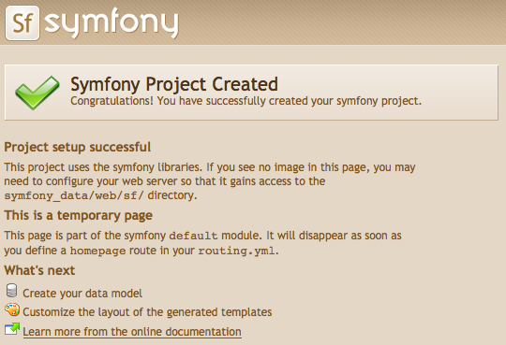
Create a project
Check
normal
http://yourdomain
debug model
http://yourdomain/frontend_dev.php/

Slide 6
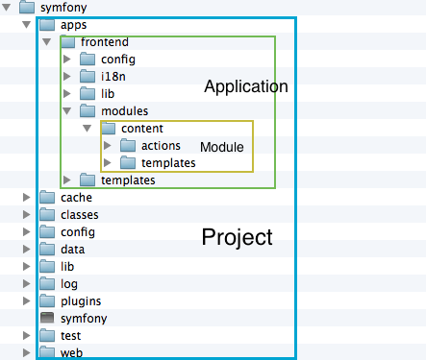
Folder structure
Structure
Project
Application
Module

Slide 7
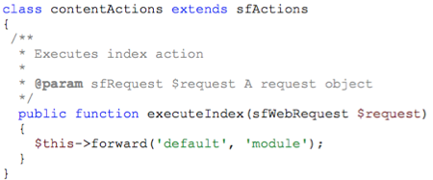
Module
Create new module
create content module for frontend
symfony generate:module frontend content
content/action/actions.class.php

Slide 8

Module
Add new action & template
new action
vim content/action/actions.class.php
http://yourdomain/content/newaction note : $request => web request info like header, get, post….
new template
vim content/templeates/newactionSuccess.php

Slide 9
Module
Give var to template
in action
$this->var;
in template
<?php echo $var;?>

Slide 10
Module
Especial action
Executing before action
public preExecute() {}
Executing after action
public postExecute() {}

Slide 11
Module
Module use symfony api doucment
http://www.symfony-project.org/api/1_4/

Slide 12
Module
Usual method
sfWebRequest $request->isMethod(‘POST’) //check request method
$request->getParameter(‘var’) //get request var value
$request->getHost() //get host
$request->isSecure() //check https protocol

Slide 13
Module
Usual method
sfContent
$this->redirect(‘module/action?param=xxx’)
$this->redirect(‘http://www.google.com’);

Slide 14
Module
Usual method
sfUser
$this->getUser->setAttribute(‘name’, $value) //set
$this->getUser->getAttribute(‘name’, $defaultValue) //get
$this->getUser->getAttributeHolder()->remove(‘name’) //remove one
$this->getUser->getAttributeHolder()->clear() //remove all
$this->hasAttributue() //check
$this->getCulture() //lang

Slide 15
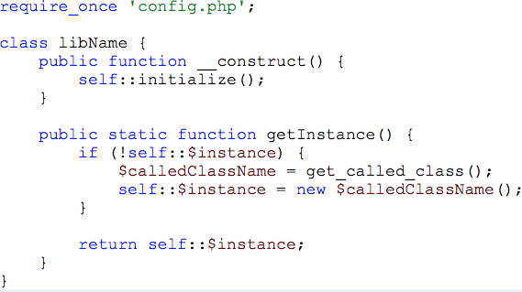
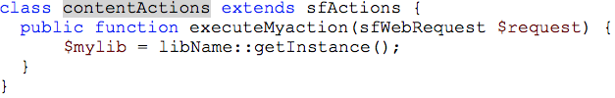
Module
Use project lib in action by autoloader feature
Step1. create a project lib class Step2. use it in action
vim /lib/libName.class

Slide 16
Module
Template type
type | In action statment | template file name
Success(default) | -- | myactionSuccess.php
Error | return sfView::ERROR | myactionError.php
None | return sfView::NONE | --
Assign | $this->setTemplate(assignname); | assignnameSuccess.php

Slide 17
Module
Use i18n user helper in view
Step1. set settings.yml(application)
i18n: true standard_helpers: I18N
Step2. change word in a template
<?php echo __('Welcome to our website.') ?>

Slide 18
Yaml format config
Define string, number, array(sfConfig convert)
Format conditions
Scalars syntax Can’t use tab
Reference website
http://symfony.com/doc/current/components/yaml/yaml_format.html http://zh.wikipedia.org/wiki/YAML

Slide 19
Yaml format config
Project config files
database.yml, schema.yml
Application files
app.yml, cache.yml, filters.yml, routing.yml, setting.yml, view.yml
Module config files
cache.yml security.yml view.yml

Slide 20
Database
Use the postgresql database
Use the propel orm to access the database
Use propel instanct in any project lib, then actions can use it by the autoload feature.

Slide 21
Database
Create models
Step1. set database.yml //project/config
Step2. set schema.yml //project/config
Step3. set propel.ini //project/config
Step4. set database for symonfy
symfony configure:database "pgsql:host=localhost;port=5432;dbname=xxxx”
Step5. create models
symfony propel:build –model //create file in lib/model

Slide 22
Database
Use it
Step1. in the project lib, propel instantiate
$db = sfContext::getInstance()-> getDatabaseConnection('propel');
Step2. in the project lib, execute a query
$sql = "select * from table;”; $stmt = $db->prepare($sql); $stmt->execute(); $data = $stmt->fetch(); //$stmt->fetchall();

